Slide 1
Where should the solar go?
Comparing E2 vs E3 for the solar-assisted heat pump dryer
20 April 2026
Agenda: base dryer → HRX → solar placement (E2 vs E3) → clipping → scale-up ideas
Notes:
Opening, casual: this is a working session, not a presentation. The goal is
to walk you through how the E2 and E3 configs are set up, what the
simulations are actually doing, and why we think E2 is the better solar
placement. Then I want to open it up to discuss scaling this to 500-1000 kg
apples and whether a multi-zone chamber makes sense as the next step.
Feel free to interrupt at any slide.

Slide 2
Base dryer: Config A (HP only, closed loop)
This is the machine before we add anything
Heat pump
Ambient air
Mix
Evap (dehum.)
Cond (heat)
Chamber (10 trays)
Exhaust
recirculation r (closed loop)
• HP condenser always heats to T_set = 45 °C; chamber holds exactly that.
• Fresh apples: 22.5 kg wet ≈ 3 kg dry. Water to remove: 19.2 kg. Drying time 13.8 h.
• 10 trays in series, cross-flow, 1.1 m/s.
Config A baseline
SEC = 0.717 kWh/kg
Kathmandu, annual, r = 0
Notes:
Talking points:
- Anchor this number in their head: 0.717 kWh of electricity per kg of water.
Every improvement from here on is referenced against this.
- Worth pointing out that the closed-loop version (r > 0) is more efficient
still (0.515 at r=0.9, from V2.1 table), but we use r=0 throughout the
solar/HRX configs because mixing is not needed once we have waste-heat
recovery from the HRX and a dedicated evap stream. Happy to discuss.
- Product spec is apple slices, 6 mm thick, 3 kg dry mass, 19.2 kg water
to remove. Current scale is small, which comes up again at the end.

Slide 3
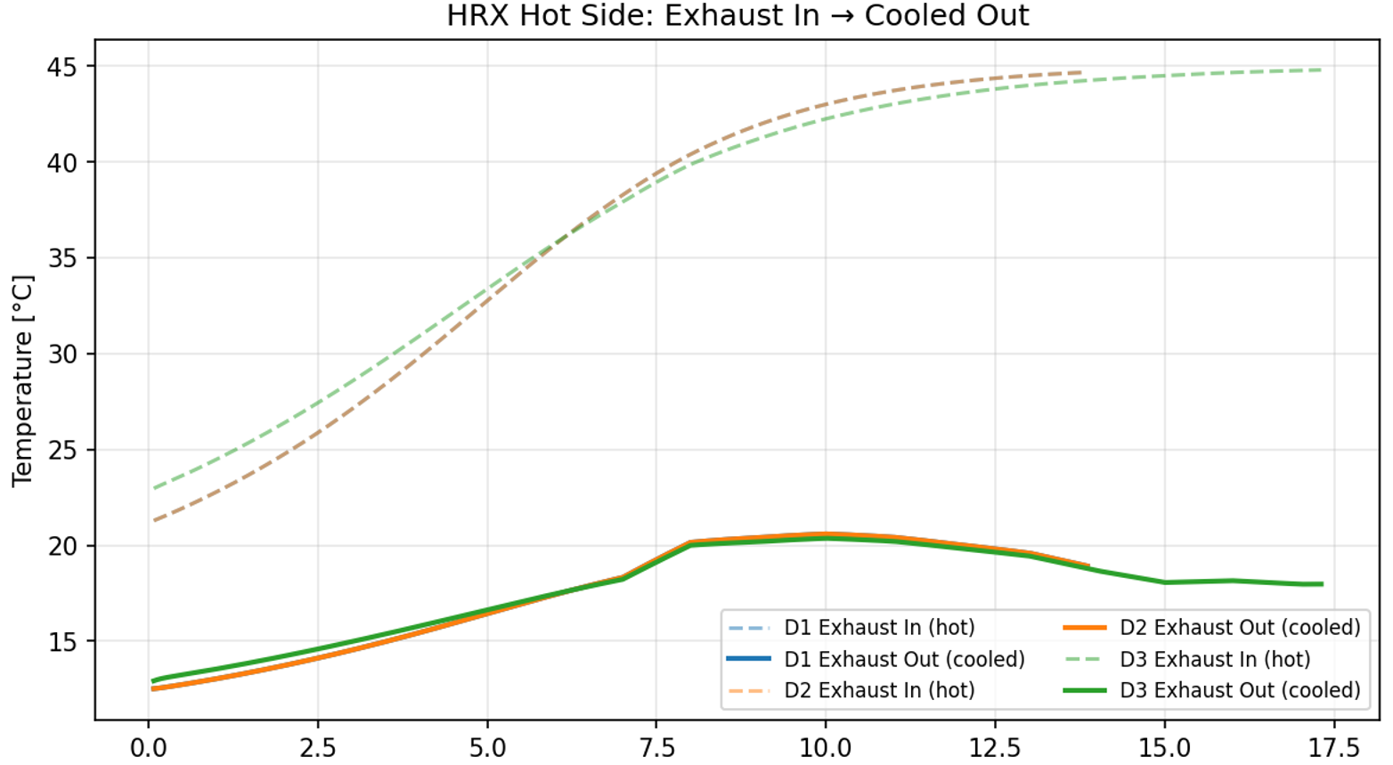
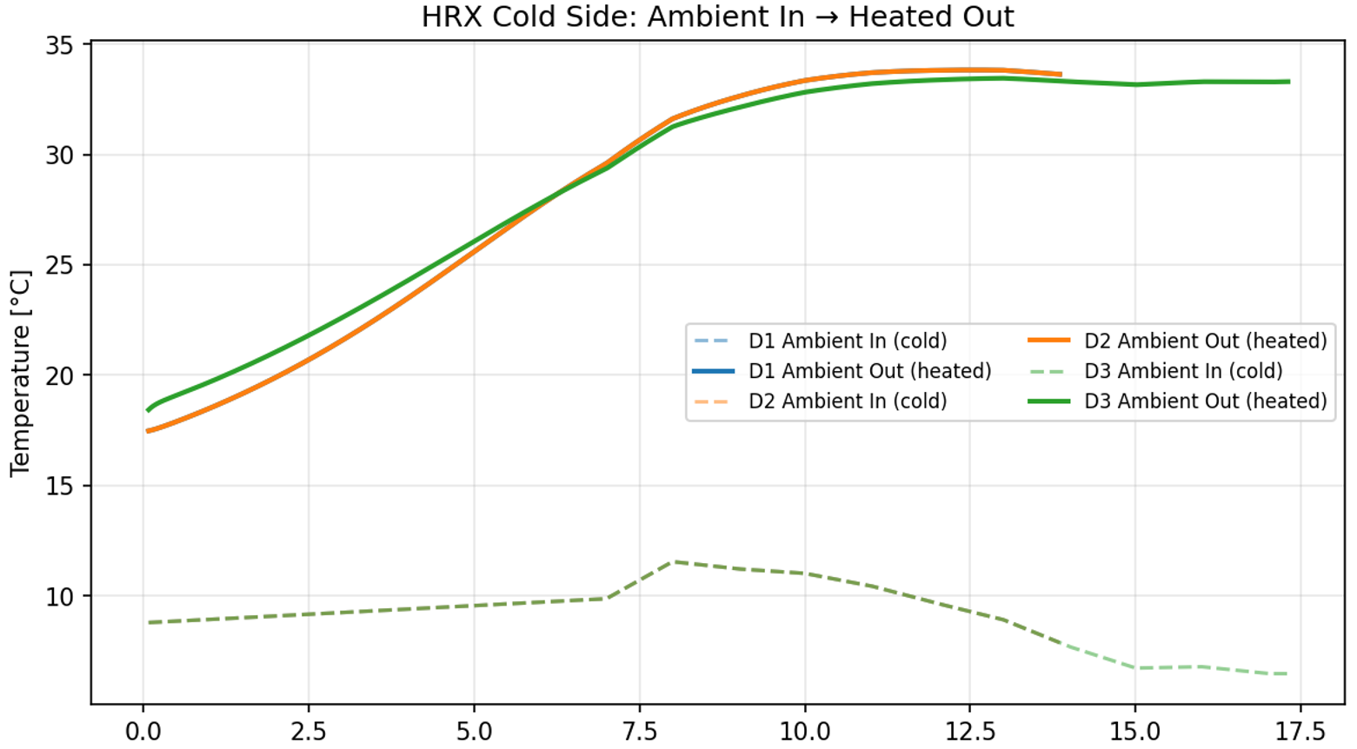
Step 1: add a heat-recovery exchanger (Config D1)
Exhaust pre-heats the condenser inlet through a 70 % effective HRX
Kathmandu annual, r = 0
Config A (HP only)
0.717
Config D1 (HP + HRX)
0.365
Config D2 (HRX + dyn evap)
0.354
HRX alone cuts SEC by 49 %.
D2 (dynamic evap) uses the exhaust that would have been thrown away,
HRX captures the bulk of the recovery. D1 vs D2 0.01kWh/kg,minor refinement
Notes:
Talking points:
- The HRX is a simple air-to-air cross-flow exchanger. The warm, moist
exhaust gives up its sensible heat to the incoming cold ambient stream.
70 % effectiveness is a reasonable commercial value.
- The result is strong: 49 % SEC drop over A, from just one passive
component. No moving parts, no control logic, no electricity.
- D2 is D1 plus dynamic evaporator compensation (the evap sizes itself
based on instantaneous ambient, not a fixed approach). The incremental
benefit is tiny, about 1 percentage point. Worth flagging that we
tested it because we suspected it mattered, and the data says it does
not, which is itself a useful negative result.
- This sets up the natural next question: can we layer solar on top?

Slide 4
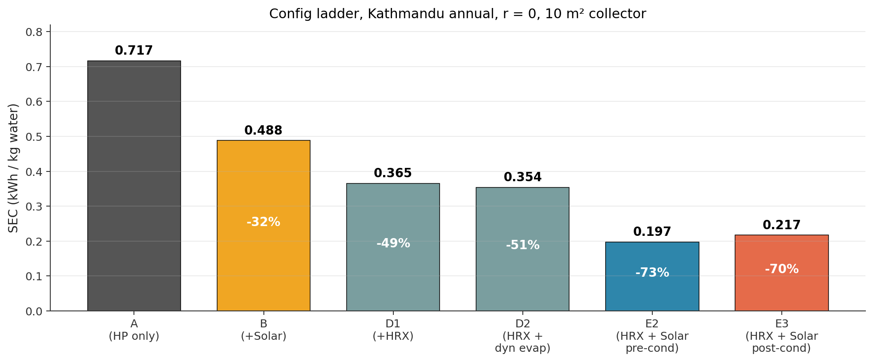
Step 2: add a solar collector (Config B)
Flat-plate collector in series before the condenser
Ambient
Solar collector
Cond
Chamber
Exhaust
• When the sun is out, solar does part of the heating. HP takes what is left to reach 45 °C.
• At night or under cloud cover, solar contributes zero and the HP runs full duty, so SEC can never be worse than Config A.
• With 10 m² collector: solar provides 32 % of total heating at Kathmandu, 46 % at Biratnagar.
• Observation: B alone beats A but does not beat D1 at Kathmandu. Solar alone < HRX alone at high altitude.
Notes:
Talking points:
- Solar is a preheat. It does not replace the HP. It just reduces the lift
the HP has to provide.
- Quick numbers: B alone gets us to 0.488 at Kathmandu. D1 alone gets us to
0.365. So at 1350 m altitude, HRX is more valuable than 10 m² of solar
by itself. That was a bit surprising when we first saw it, and it
motivated combining them (E series).
- The ladder chart tells the whole story: each component buys us something.
The open question: when we combine HRX + solar (E series), where exactly
should the solar sit in the stream?

Slide 5
The question: where does the solar go in E configs?
Both have an HRX and a solar collector, only the ordering differs
E2: Amb → HRX → Solar → Cond → Chamber
Control logic differs
Amb
HRX
Solar
Cond
Chamber
Exh
E2: Cond targets T_set
If solar delivers the air already above 45 °C, the simulator clips to T_set and HP idles (Q_cond = 0). Any extra solar heat above 45 °C is discarded (no storage).
exhaust pre-heats HRX (70 % effective)
E3: Solar-priority
HP modulates T_cond so that T_after_solar exactly equals T_set. If solar alone from the HRX output reaches T_set, HP goes OFF entirely. No clipping by design.
E3: Amb → HRX → Cond → Solar → Chamber
Amb
HRX
Cond
Solar
Chamber
Exh
exhaust pre-heats HRX (70 % effective)
Notes:
Talking points:
- This is the crux slide. Two seemingly-equivalent layouts, both deliver
45 degree air to the chamber. Naively one might guess E3 is better
because its HP can idle completely in strong sun.
- The control logic is important. In E2 the condenser is the final gate
and always targets 45. In E3 the collector is the final gate, so the
HP has to modulate its discharge pressure to leave the solar "just
enough room" to land exactly at 45.
- Both are physically defensible topologies. Nobody has published a
head-to-head comparison with a validated thermodynamic model, which is
why we spent time on it.

Slide 6
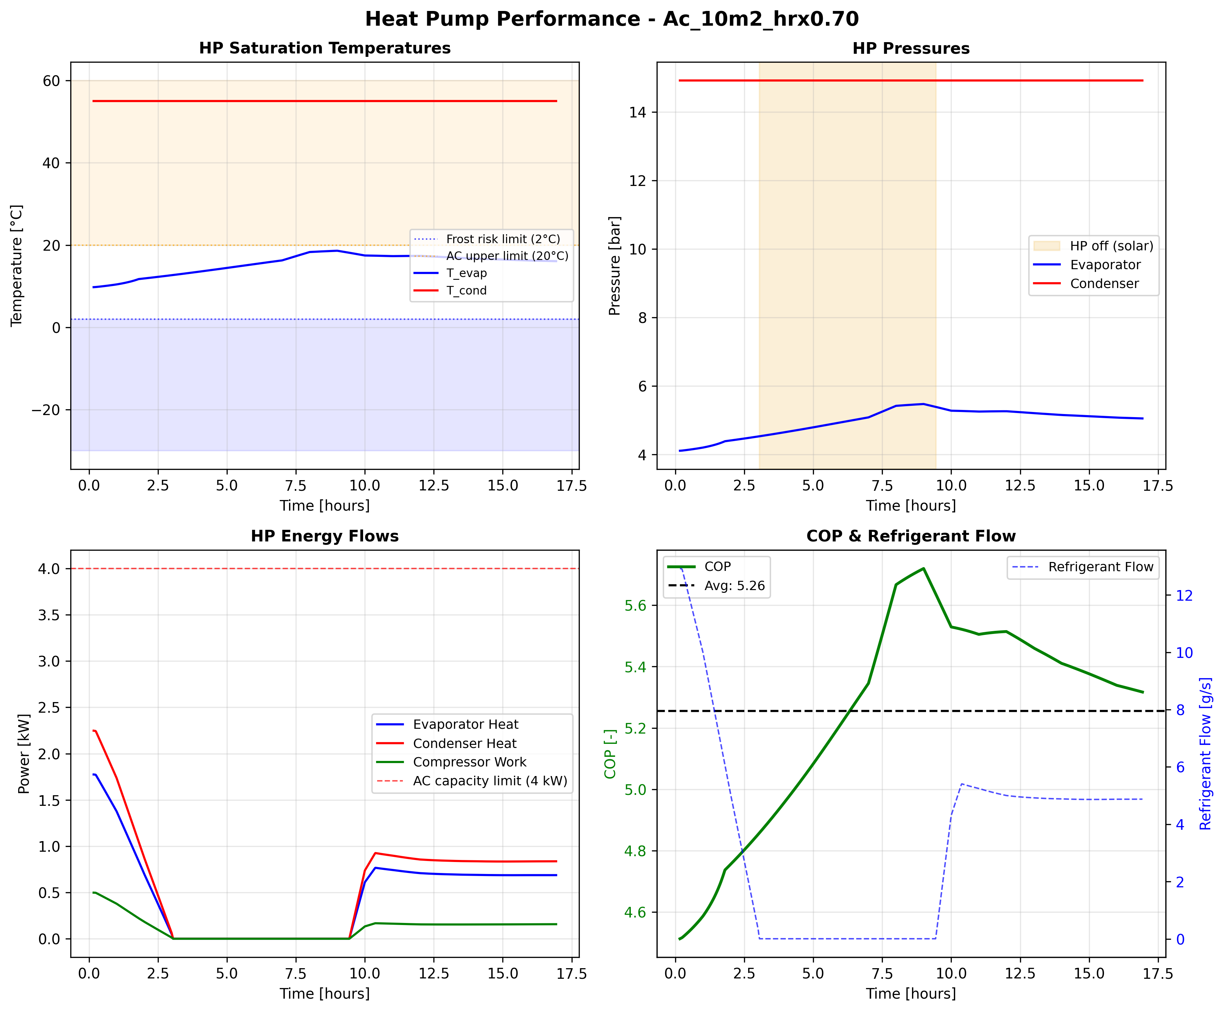
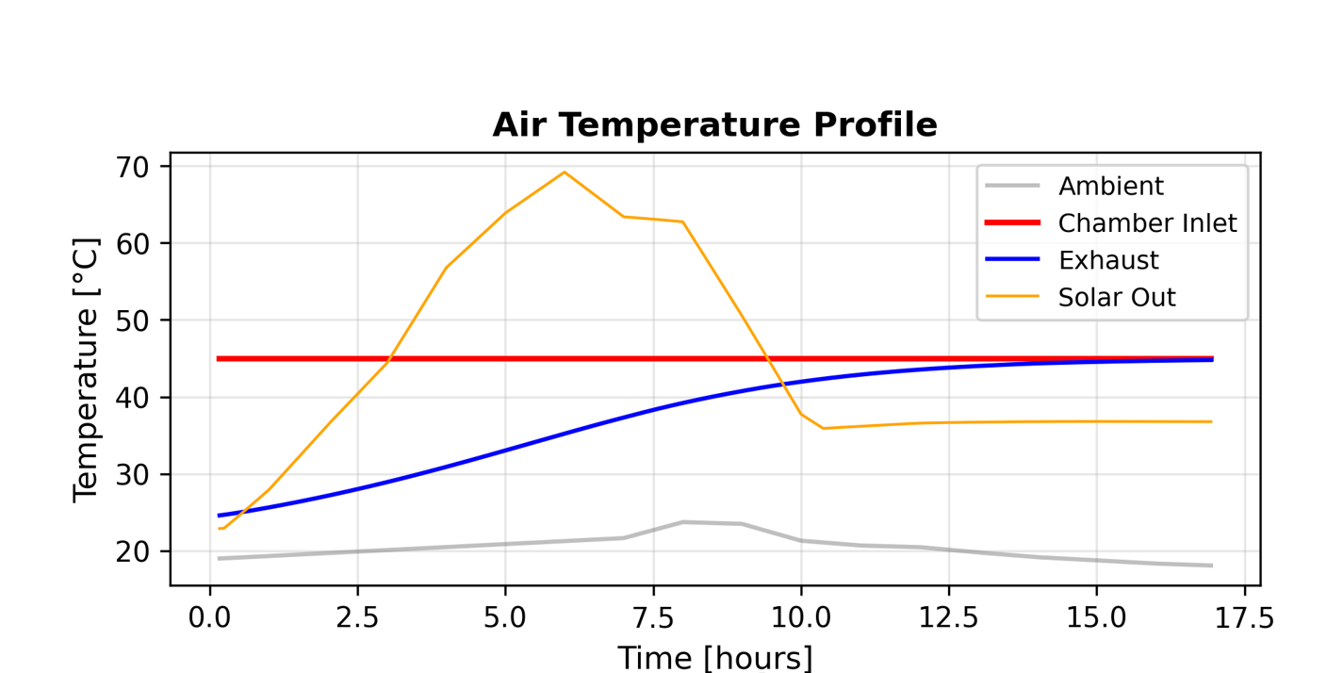
E2 in action (Kathmandu autumn, 10 m²)
Solar lifts before the condenser; condenser fills the gap to 45 °C
E2 behaviour
• T_chamber holds 45 °C the entire run
• HP runs when solar outlet is not sufficient
• SEC = 0.123 kWh/kg
• Mean COP over run = 5.25
• Total drying time 16.9 h
Notes:
Talking points:
- Point to T_chamber at 45 flat. That is the control law working.
- Point to W_comp: the compressor never goes to zero during daylight. It
dips when solar is strong but always keeps some load because the
condenser is the final heater.
- SEC 0.123 at 10 m2 is a very good number for this climate. The
reference Config A is 0.500 for autumn KTM at r=0. So E2 is a
75 percent reduction from the bare HP baseline in autumn alone.

Slide 7
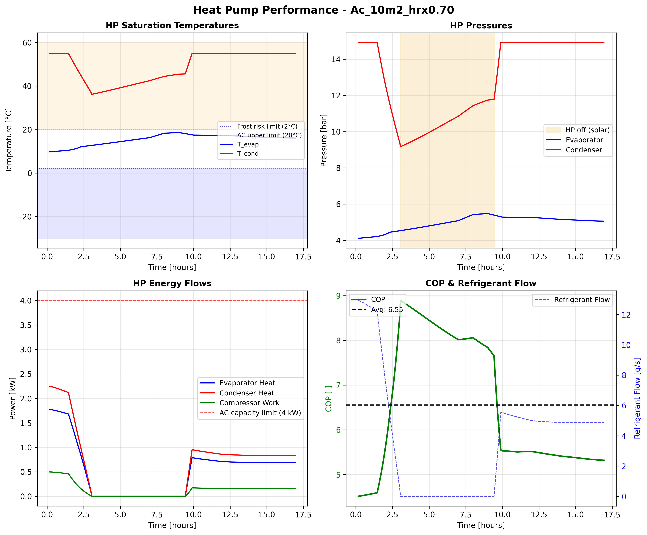
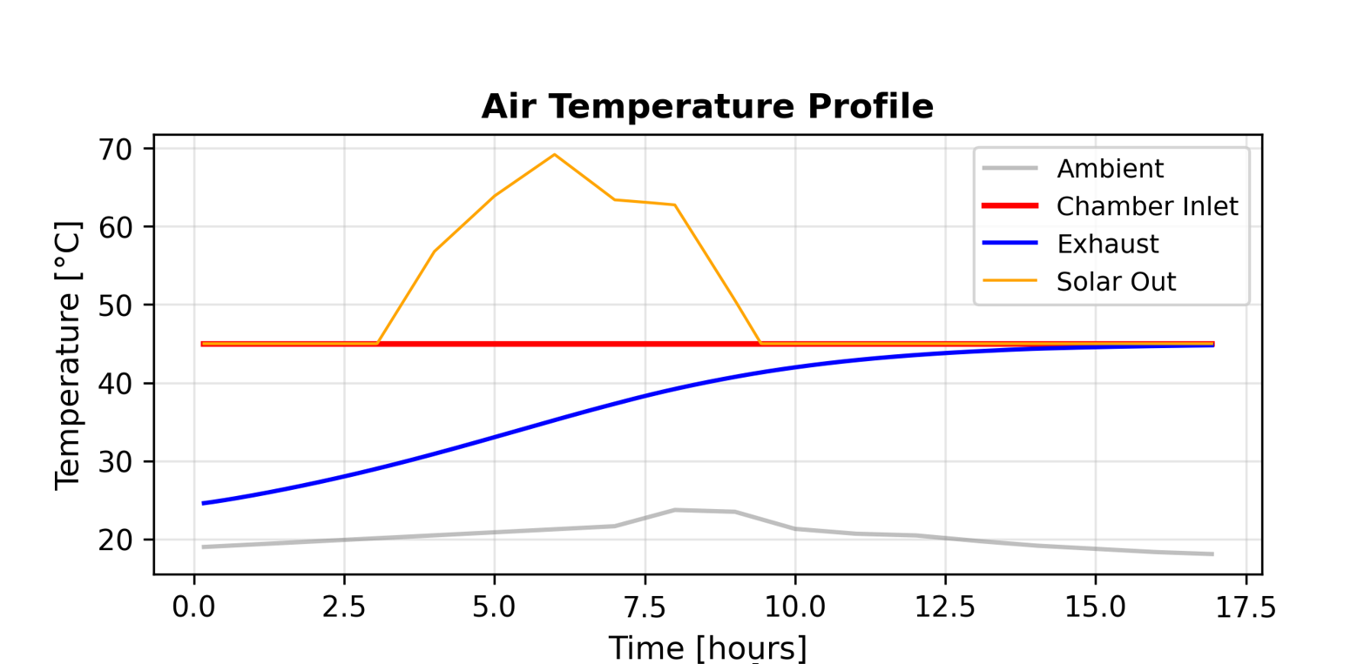
E3 in action (Kathmandu autumn, 10 m²)
HP modulates T_cond to leave solar just enough room to reach 45 °C
E3 behaviour
• T_chamber holds 45 °C (different path, same outcome)
• HP turns OFF entirely around solar noon
• SEC = 0.133 kWh/kg
• Mean COP = 6.53 (higher than E2)
• No clipping: 100 % of collected solar reaches the chamber
Notes:
Talking points:
- Look at the W_comp trace: it goes flat at zero during peak sun. That is
the HP stepping out of the way and letting solar do everything.
- Higher COP is real: when the HP does run, it runs at a much lower
pressure ratio because T_cond is modulated down. So every kWh of
compressor work delivers more Q_cond.
- Here's the puzzle: E3 has the higher mean COP AND the higher peak COP
AND no clipping. So why doesn't it win? Transition to the next slide.

Slide 8
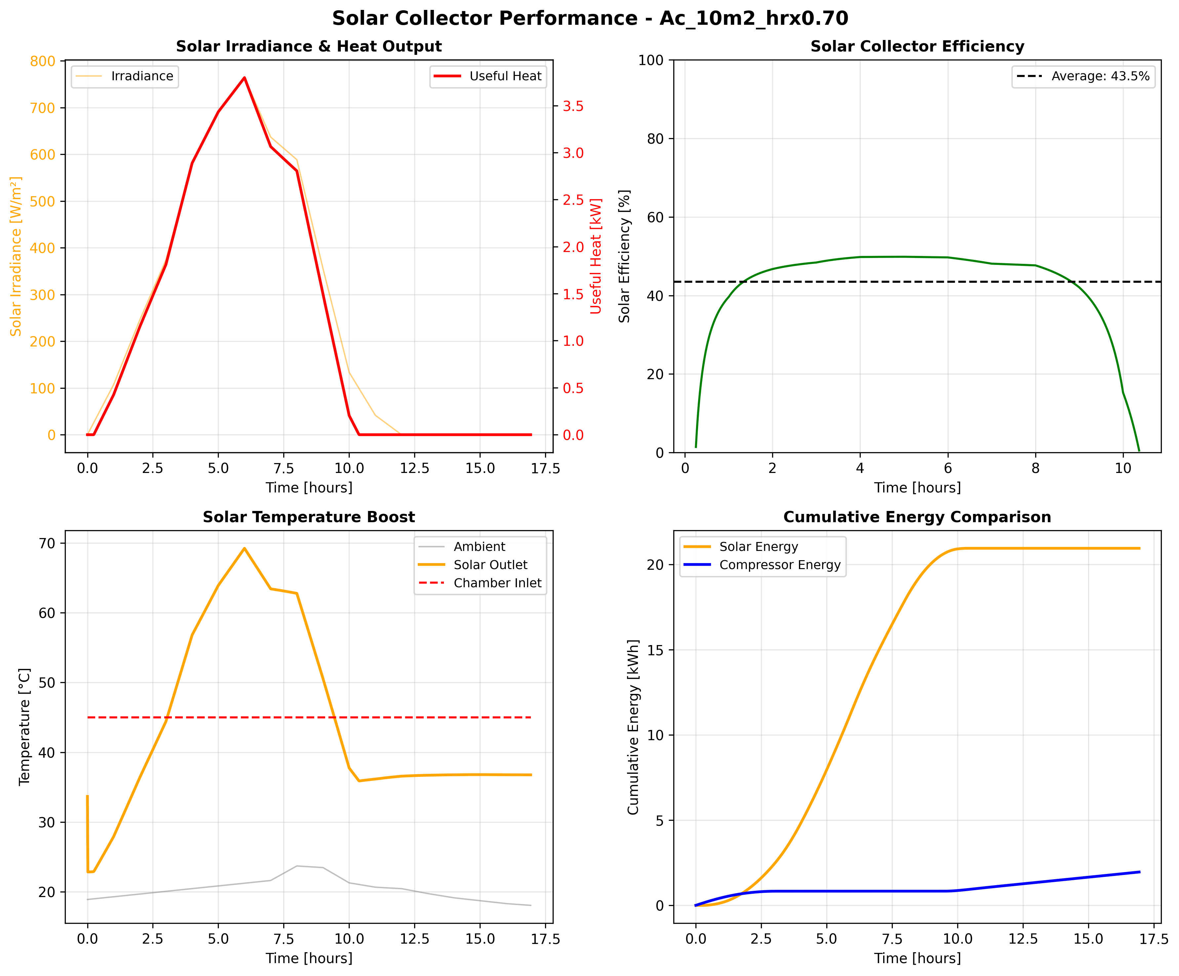

Side-by-side: what each config actually does
Autumn KTM, 10 m², r = 0, identical weather, identical drying time (16.9 h)
E3 solar
Hotter inlet
~37 °C (HRX + Cond)
Collected 19.77 kWh
No clipping (design)
Usable 19.77 kWh
E2 solar
Cooler inlet
~32 °C (HRX only)
Collected 20.95 kWh
Clipped 9.38 kWh
Usable 11.57 kWh
The paradox: E3 has higher COP + no clipping + more usable solar, yet E2 uses less total W_comp (1.96 < 2.16 kWh). E2's cooler collector wins across every HP-ON hour, not just midday.
Notes:
E2 on high-insolation hours the collector outlet can exceed T_set.
The simulator enforces
T_air_in,cond = min(T_after_solar, T_set),
So any surplus is effectively wasted.
(E3 topology) to avoid clipping does not reclaim that energy ,
Instead it degrades the collector’s loss term
And the HP has to make up the shortfall.

Slide 9
The punchline: why E2 beats E3
Collector inlet temperature is everything (Hottel-Whillier-Bliss)
E2
E3
The physics
SEC (kWh/kg)
0.123
0.133
Hottel-Whillier-Bliss:
Mean COP
5.25
6.53
η_c = F_R(τα) − F_R U_L (T_in − T_amb) / G
Solar collected (kWh)
20.95
19.77
In E2 the collector sees air at ~32 °C (HRX output, mid-drying).
In E3 the collector sees air at ~37 °C (HRX + condenser output).
That 5 °C hotter inlet costs roughly 2.5 percentage points of energy-weighted efficiency.
E2 captures +1.2 kWh extra solar per day; E3's lower compressor work saves only ~1.0 kWh thermal. E2 nets +0.2 kWh/day.
Keep the solar upstream of the condenser.
Solar usable (kWh)
11.57
19.77
Clipping waste
44.8 %
0 %
Autumn Kathmandu, 10 m² collector
Notes:
Talking points:
- Hottel-Whillier-Bliss is the standard flat-plate collector equation.
The second term is the thermal loss: hotter collector inlet means more
heat leaks to ambient, lower efficiency.
- In E3, the stream going into the collector has already been lifted by
the condenser, so it arrives hotter. The collector runs less
efficiently because it is trying to heat an already-warm stream.
- In E2, the collector inlet is cooler (just ambient + HRX), so it runs
more efficiently. The HP then "tops off" any remaining lift.
- The COP story is a distraction. Yes E3 has higher COP. But the
collector inefficiency costs more than the COP gain buys us.
- Practical takeaway: always put the solar upstream of the condenser in
a series topology. This is the answer to "where should the solar go".

Slide 10
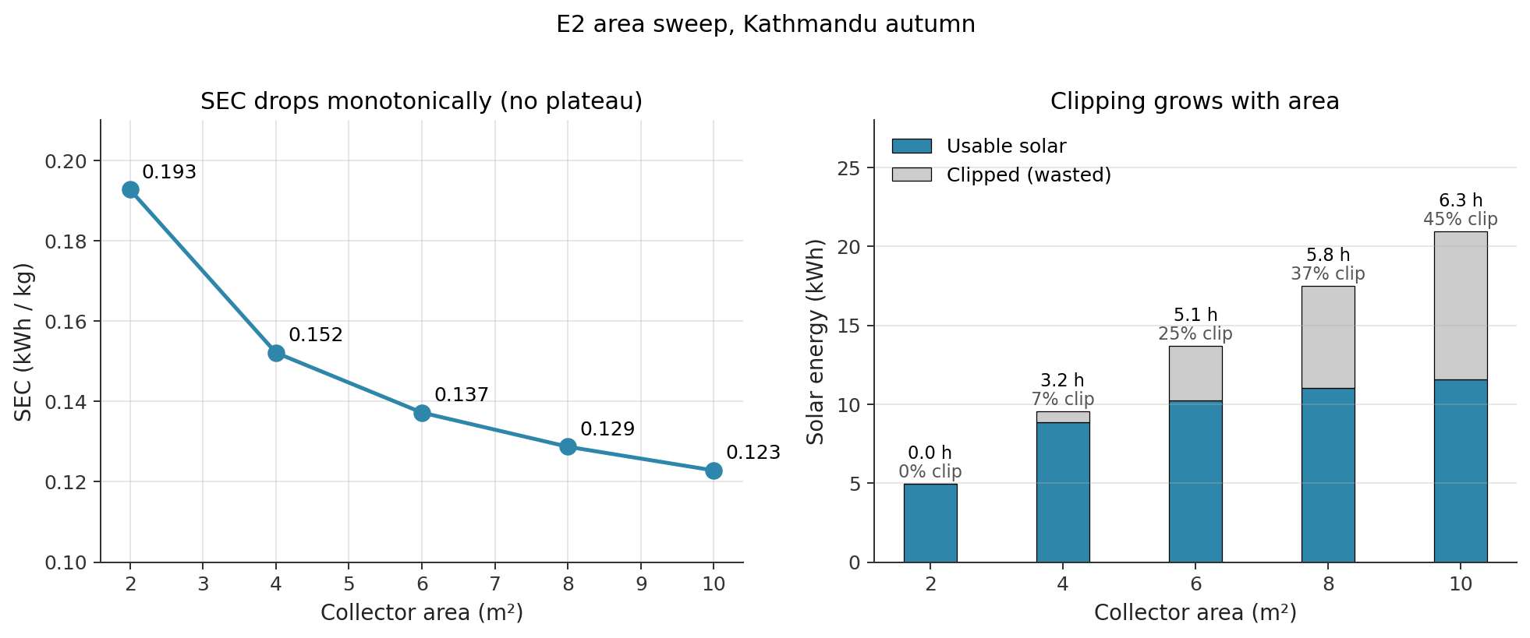
Area sweep: SEC keeps dropping even as clipping rises
Shrinking the collector to avoid clipping makes things worse
Extra area always buys extra useful solar. The HP duty cycle drops faster than clipping waste grows. Right fix: keep area, add storage, not shrink area.
Notes:
Talking points:
- One might intuitively say: clipping is waste, let's downsize the
collector. The data says the opposite. Even at 44 percent clipping,
the remaining usable fraction still does more useful work than a
smaller collector would.
- Monotonic SEC drop from 0.193 at 2 m2 to 0.123 at 10 m2. No plateau
in the 2-10 m2 range. We tried 15 and 20 m2 too and still saw small
improvements.
- Insight: the HP duty cycle drops faster than the collector efficiency
does. Every kWh of usable solar displaces HP electricity that would
otherwise have been spent, and the HP duty cycle is the dominant cost.
- The correct engineering response to clipping is thermal storage:
capture the midday surplus, release it in the evening.

Slide 11
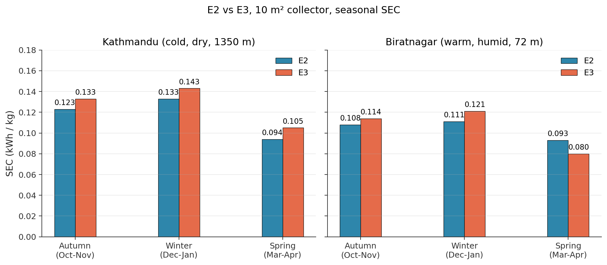
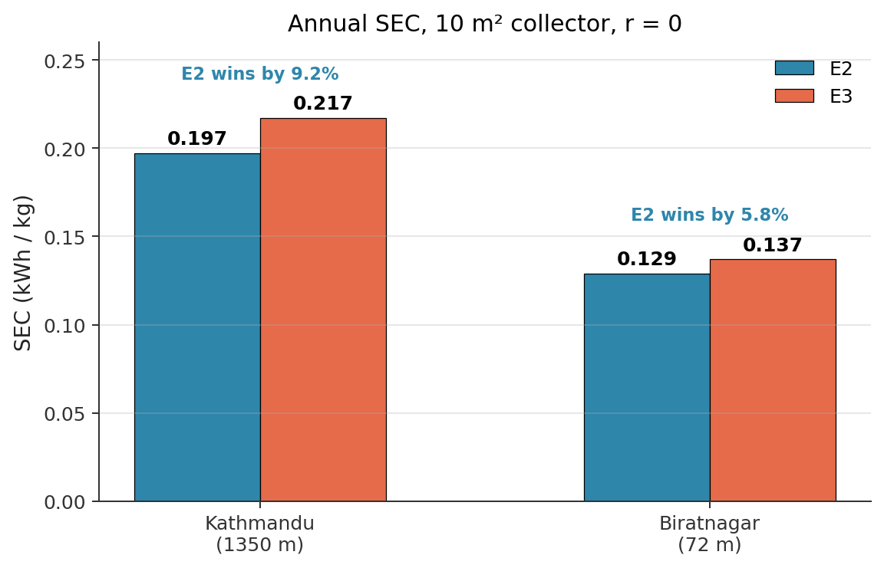
Seasonal performance across two climates
E2 beats E3 in every season, at both locations
E2 advantage is consistent: 7-9 % at Kathmandu, 6-7 % at Biratnagar. Spring is best at both (strongest irradiance, moderate ambient, best collector efficiency).
Notes:
Talking points:
- Four seasons, two climates, eight data points. E2 beats E3 on all
eight. The mechanism is universal, not a fluke of one dataset.
- Spring is the best season at both locations because the sun angle is
good and the ambient is not yet too hot (low U_L*(T_in - T_amb) loss).
- Biratnagar is always absolute-lower SEC because warmer ambient means
smaller HP lift and better collector efficiency. But the E2 vs E3
advantage is almost the same percent.
- If we had time we could run Taplejung (1820 m, even colder) but the
mechanism would play out the same way.

Slide 12
Key takeaways
Three things I want to leave you with
1. Put the solar upstream of the condenser.
E2 beats E3 by 7-9 % SEC in every season at both climates. Collector inlet temperature dominates the combined efficiency of a series HP+solar topology.
2. Peak COP is a distraction. SEC is what matters.
E3 has higher COP and zero clipping, yet loses on SEC. High COP on a smaller duty cycle can still cost more than low COP on a bigger one.
3. Clipping is a sign to maybe add thermal storage.
Clipping happens every clear day, 6+ hours a day, because the stream state forces the HP to idle when solar alone reaches T_set. The fix is storage.
Notes:
Talking points:
- Each of the three gets about 30 seconds of discussion. The first is the
engineering answer to the research question. The second is a mental
model correction: COP has been overweighted in the SAHPD literature.
The third sets up the scale-up slide by pointing at storage as the
missing piece.
- Offer to open up: does the professor want to discuss any of these?

Slide 13
What's next: scale-up and thermal zones
Going from 3 kg dry (lab) to 500-1000 kg fresh (small commercial)
Multi-zone chamber concept (4 zones shown)
Hot-air distribution manifold (from Cond + Solar)
Capacity scaling (rough)
Dry mass
3 kg
70 kg
140 kg
Fresh mass
22.5 kg
500 kg
1000 kg
Water removed
19.2 kg
427 kg
854 kg
Scale factor
1×
22×
44×
Zone 1
Zone 2
Zone 3
Zone 4
Trays (current geometry)
10
~220
~440
trays
trays
trays
trays
Collector area (same SEC)
10 m²
220 m²
440 m²
Why thermal zones (not longer single chamber)
• Multi-inlet per zone → every zone operates in high-VPD region → shorter, more uniform drying.
• Per-zone VPD bypass control becomes natural: dry zones can go cond-direct early.
• Caveat: needs distribution manifold + multi-fan + control logic.
Exhaust plenum → back to HRX
Each zone gets fresh 45 °C air via the manifold; each zone's exhaust routes back through its own HRX branch.
Notes:
Talking points:
- Current lab scale is 3 kg dry mass. That gets us to interesting physics
but nowhere near a useful throughput. To dry even one small orchard's
apple crop in a season we need 500-1000 kg fresh per batch.
- Linear scaling (just make the chamber bigger) does not work. Our
validation data (V2.3) shows RH climbing from 29 to 84 percent across
10 trays in wet phase. Add more trays and the tail of the chamber is
just a hot humid pipe doing no useful work.
- Thermal-zone architecture: split the chamber into N zones, each with
its own hot-air inlet from a distribution manifold. Each zone sees
fresh 45 degree air instead of air that already passed through 5 wet
trays. Every zone operates in a high-VPD regime.
- This also enables per-zone control: a nearly-dry zone can switch to
condenser-direct bypass early while wet zones still dehumidify. VPD
bypass logic is already validated in Config A (V3 in the report).
- Open question for discussion: how many zones is optimal? Is there a
diminishing return? And what is the CAPEX penalty of the manifold
and multi-fan setup?
- Collector area scales roughly linearly with water mass if we want
the same SEC. 220 m2 for 500 kg fresh is a realistic rooftop number
for a small orchard processing building.
- The thermal storage retrofit from the clipping discussion fits in
here: at 220 m2 the absolute clipped energy is huge, so the case for
storage gets stronger as we scale up.

